Slide 1
Securing Data on the High Seas
Captain Brett “Scalawag” Whittington
Notes:
If you haven’t already been able to tell, this presentation is going to be a little SILLY.

Slide 2
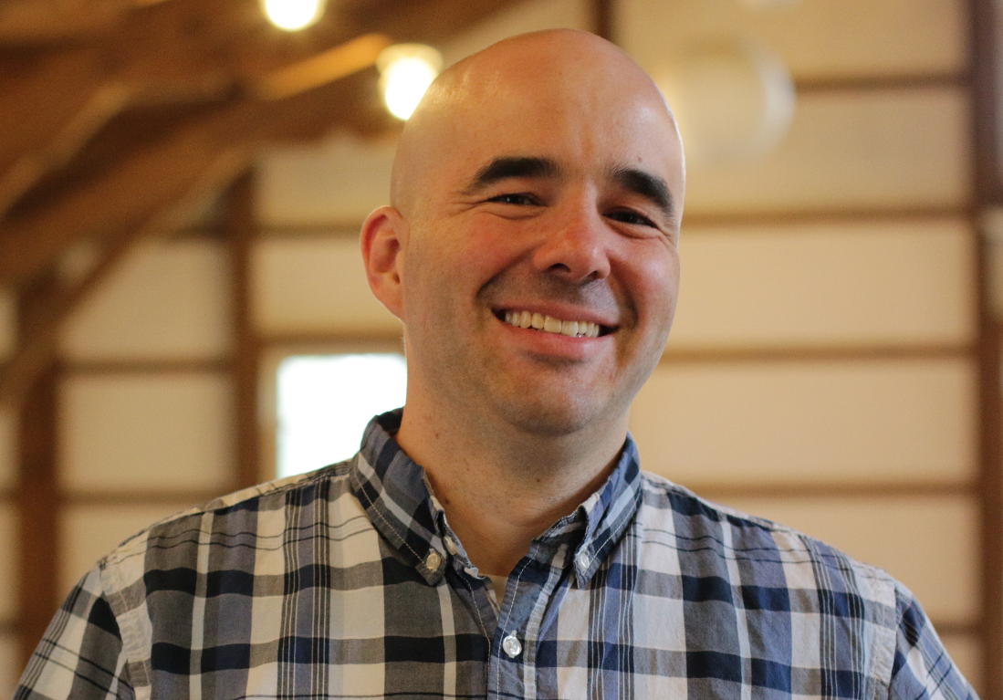
Brett Whittington
Senior Developer and Sitefinity Lead
Worked in the industry for 12 years and @HMB for 5 years
@BrettTheWhitt
https://www.brettthewhitt.com

Slide 3
Securing Data on the High Seas
Protect our plunder
Plunder Loot
Profit
Make it hard to read
Watch for threats
Tools of the Trade
Put deadly obstacles in the way
Scan the horizon
???
Chart Our Course

Slide 4
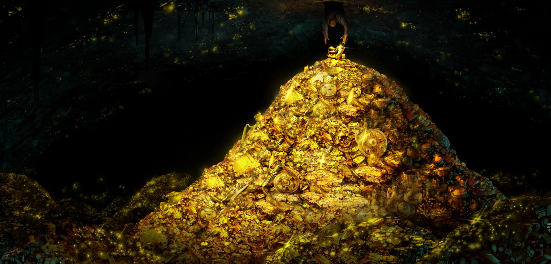
What is our Plunder?
PII – Personal Identifiable Information
Business Intellectual Property
Notes:
Non-Sensitive PII
Sensative PII
IP
Basically anything about yourself or your business that you want to keep private and out of the hands of pirates.

Slide 5
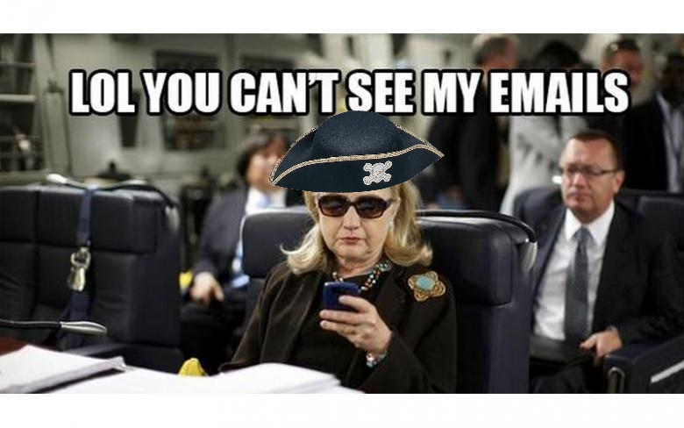
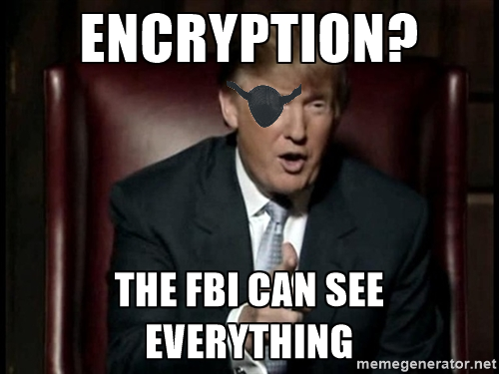
So now I know what plunder is…
Who am I protecting it from?
Why should I care?
Notes:
You’re protecting yourself from individuals, businesses, and government. 99.9% do not intend to cause you harm but inadvertently do.
Why should you care?
It affects your everyday life
Imagine if your employer was sending your bank account details as well as wiring your money through an unprotected transfer.
It also affects society
One side you have a group that take it for granted
On the other you have people who think they should have access to everything.

Slide 6
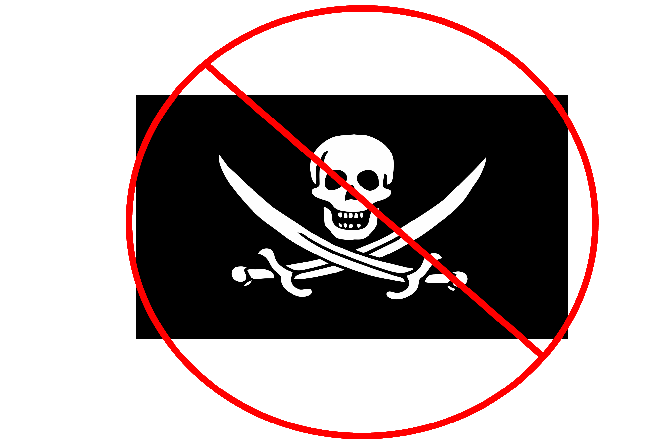
Protecting Our Plunder

Slide 7
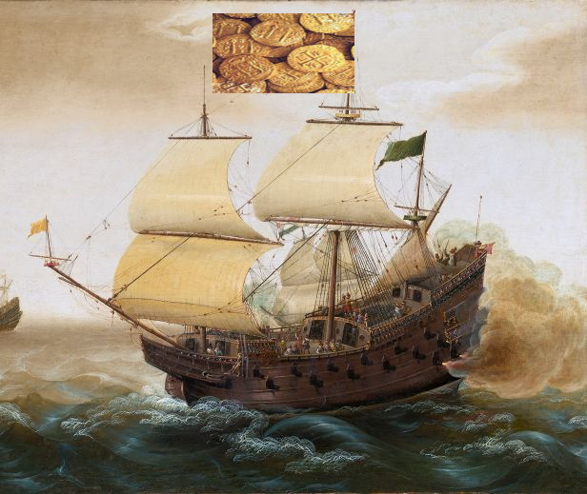
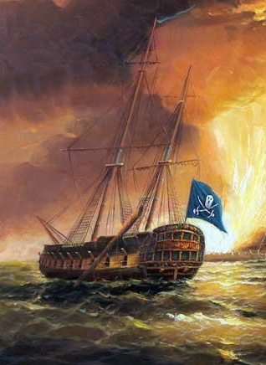
Protecting our Plunder
Once our data leaves port, our data is no longer in a safe location.
Notes:
It’s not easy protecting data that currently lives on our servers. It’s especially difficult when we allow users to access to our data through normal means. What is even harder is keeping our data safe when we don’t have control at ALL once it leaves. All we can do is tell it where to go and it takes its own path to get there.

Slide 8

Protecting our Plunder
Encrypt it!
Notes:
So we might hide what we are carrying by waving another flag
We encrypt the data so it looks like something else and is not readable by others except by those on the receiving end of the path.
This makes our data, “unreadable”

Slide 9
Protecting our Plunder
Encrypt ALL the time
Benefits
All of your requests are secured
Google give a slight ranking boost to secured sites
Negatives
It impact server performance (< 1% CPU, < 2% network overhead as found by Google)
Notes:
Should always encrypt otherwise others who might be watching will know when valuable data is being sent.

Slide 10
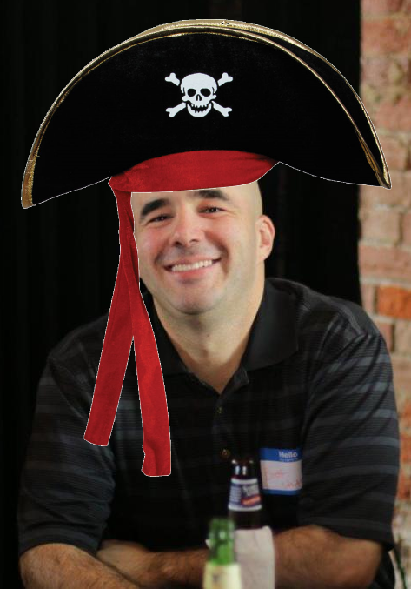
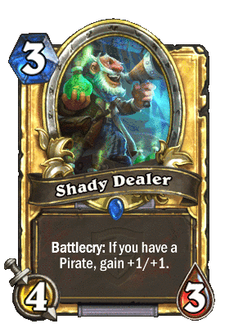
Biggest Risks To Our Plunder
Ourselves
Places We Do Business

Slide 11
Charting Our Course

Slide 12
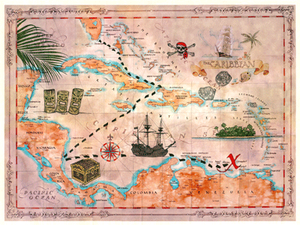
Where is our Plunder going?
rrcs-74-62-109-209.west.biz.rr.com [74.62.109.209]
69.23.11.5
be49.clmkohpe02r.midwest.rr.com [24.33.162.26]
be27.clmkohpe01r.midwest.rr.com [65.29.1.34]
bu-ether15.chctilwc00w-bcr00.tbone.rr.com [66.109.6.68]
lag-82.ear2.chicago2.level3.net [4.68.72.197]
yahoo-inc.ear3.newyork1.level3.net [4.15.212.174]
et-19-1-0.msr1.bf1.yahoo.com [74.6.227.133]
et-0-1-0.clr1-a-gdc.bf1.yahoo.com [74.6.122.13]
po7.fab7-1-gdc.bf1.yahoo.com [72.30.22.13]
po-15.bas1-7-prd.bf1.yahoo.com [98.139.129.241]
ir2.fp.vip.bf1.yahoo.com [98.139.183.24]

Slide 13
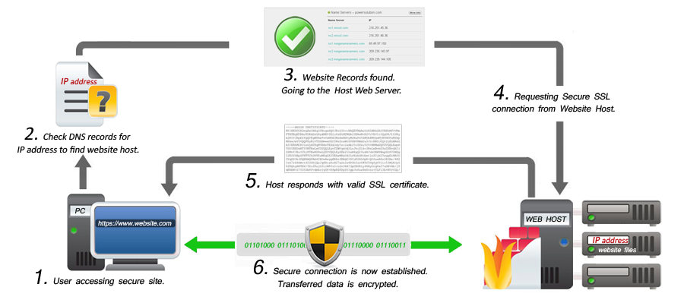
How does it get there?
Plundered from https://innovativecodes.com/news-and-articles/were-now-running-under-ssl
Notes:
We can secure our connection with either SSL or TLS

Slide 14
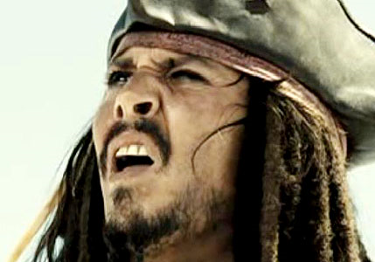
Wait Wut? TLS vs SSL?
Notes:
TLS and SSL are both protocols with TLS being the successor. There is a slight difference in how they are handled

Slide 15
Two Types of Configuration
Explicit
Implicit
SSL – secure handshake happens first
TLS – simple insecure wave first
If both parties agree then secure handshake.

Slide 16
HTTP/2
New protocol to improve on http1.1
The standards committee tried to make encryption required but failed
Does NOT require TLS encryption
Nearly all modern browsers REQUIRE it anyway.

Slide 17
Setting Up Encryption Is Easy
All you need is a certificate!
Certificate is a digital document that ensures the content provided is from the correct sender.
You can create your own certificate using IIS or most other web servers.

Slide 18
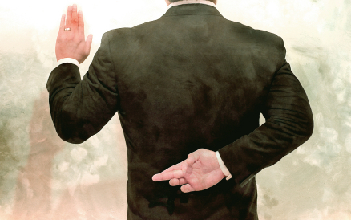
I swear…
Your basically asking a user to take your word for it.

Slide 19
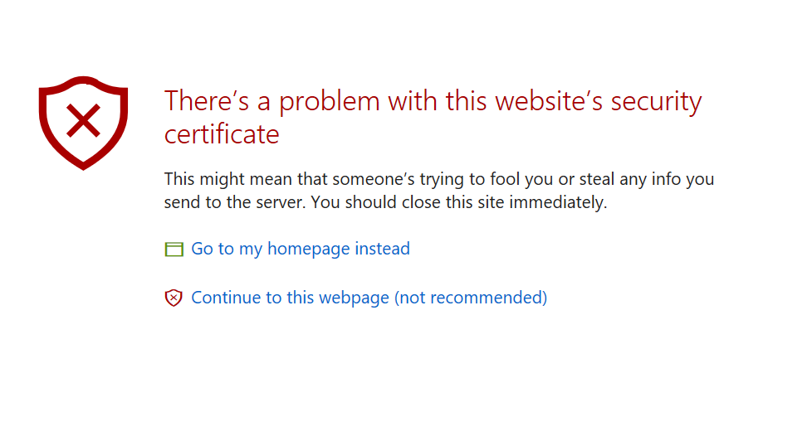
Protecting Our Plunder
If encryption for data in motion was so easy, why isn’t everyone encrypting their data.
Not all encryption is created equal.
There has to be some level of TRUST.
Notes:
If encryption for data in motion was so easy, why isn’t everyone encrypting their data.
It’s super easy to make a self signed certificate and that would ensure that my data is encrypted.
This isn’t enough though!!!!
Internal communication could get away with something like this in a company but in my opinion it is super unprofessional.

Slide 20

Levels of Trust
Domain Validation (DV)
CHEAP
Only confirms that the domain holder owns the domain
Notes:
The barest level of trust. Basically stating that someone paid for something and owns something. It basically makes internet traffic expensive enough that can’t try to appear legitmate.

Slide 21
Levels of Trust
Organization Validation (OV)
Certificate Authority takes additional steps to confirm identity
Phone Number, Locations
Doesn’t affect the way the url looks

Slide 22
Levels of Trust
Extended Validation (EV)
OV Validation but with more factors and independently validated by two auditors and 3% of all EV’s must be re-evaluated each year.

Slide 23
How to Secure Your Data
Wild Card
Multi-Domain
Secure an unlimited amount of subdomains
*.hmbnet.com
Cannot get an EV certificate
Allows specified number of fully qualified domains.
Hmbnet.com
Allows adding, editing, and delete of domains
Can also use this *.hmbnet.com
Must be spelled out.

Slide 24
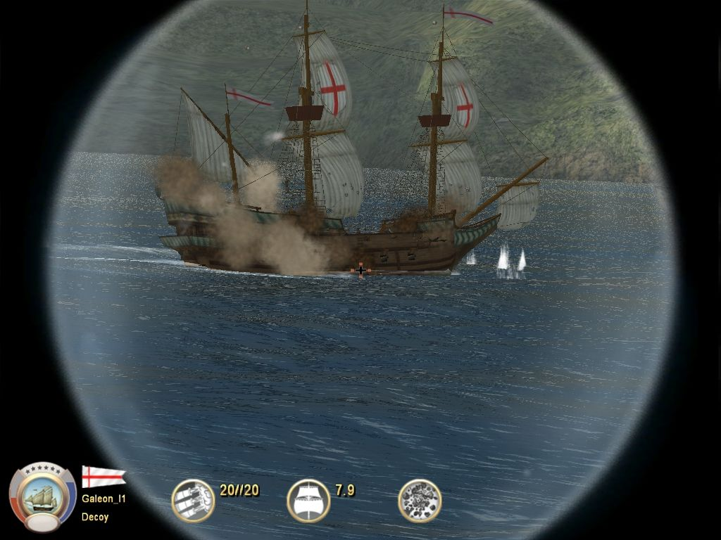
Watch for Threats

Slide 25
Top 1 Million Website Grades
Notes:
https://www.trustworthyinternet.org/ssl-pulse/ - 01/2017
It’s insane how exposed most websites still are.

Slide 26
49% are not “perfectly” secure
How do I make sure my site is protecting my customers?
You have to be proactive in checking your site, certificate, and web server.
Notes:
Just because you have an SSL certificate does not mean you are secure.

Slide 27
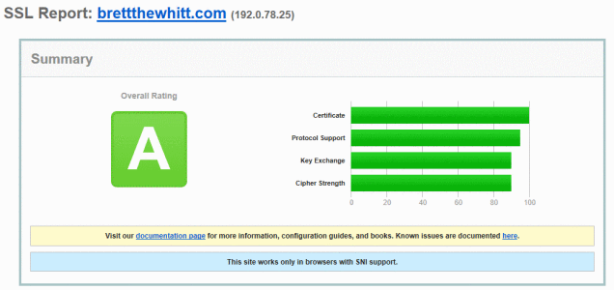
SSL Labs

Slide 28
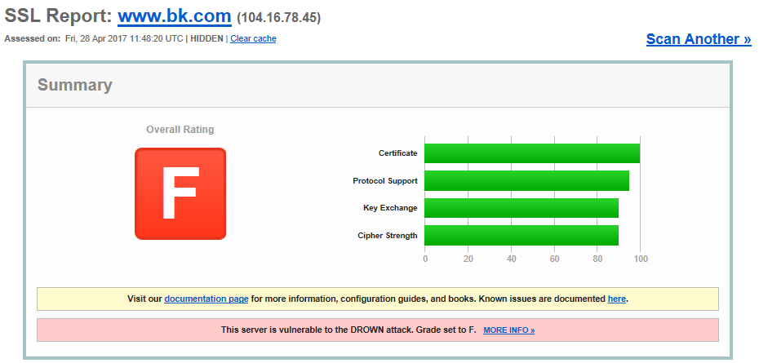

Slide 29
Security Protocols
SSLV1
SSLV2
SSLV3
TLS 1.0
TLS 1.1
TLS 1.2

Slide 30
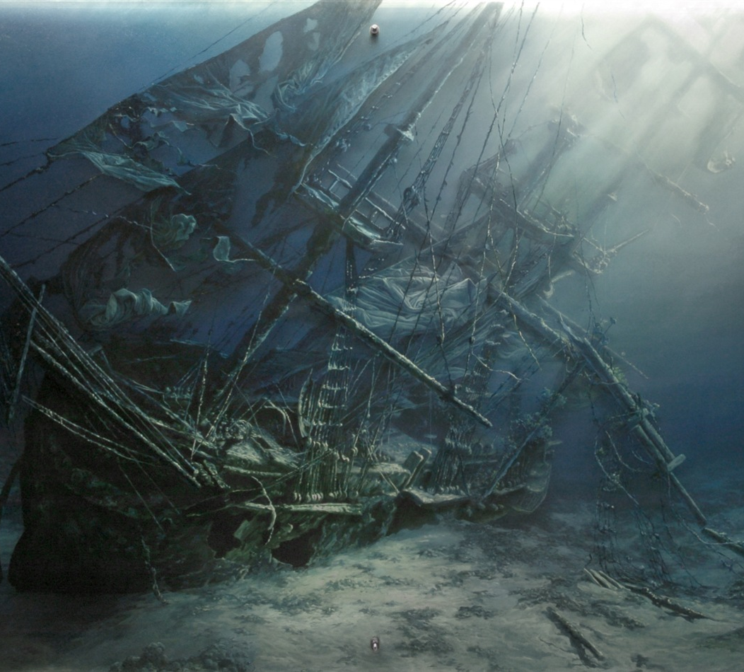
SSL
The SSL Protocol is functionally dead and cannot be considered secure at all.

Slide 31
SSL V1 - DOA
Philip Hallam-Baker – helped write Verisign
The actual history of SSL was that SSL 1.0 was so bad it was broken in ten minutes when Marc Andressen (Co-Founder of Netscape) presented it at the MIT meeting.

Slide 32
SSL V2 (1995 – 2011)
No protection from against man-in-the-middle attacks during the handshake
Uses MD5 Hash Method
A collision attack exists that can find collisions within seconds on a computer with a 2.6 GHz Pentium 4 processor (complexity of 2^{24.1}).[

Slide 33
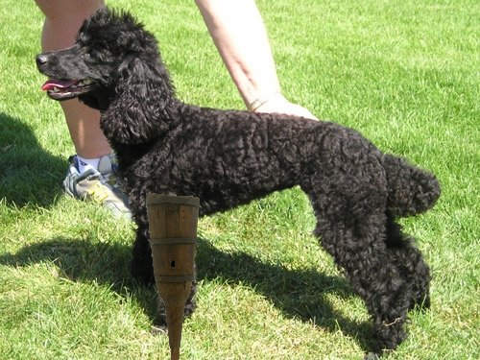
SSL V3 (1996 – 2015) TLS 1.0 (1999 - 2015
POODLE
Notes:
Poodle is a man in the middle attack that allows a hacker the ability to uncover encrypted cookies by padding request sent by the user to the server. There is a small chance that the server will return a valid response that uncovers 1 byte of the cookies information. By repeatedly changing the size of the padding, a hacker can eventually uncover the entire cookie.

Slide 34
TLS V1.1 (2006 – 2017)
Due to it’s use of SHA-1 TLS 1.1 is broken
2015 – Marc Stevens, Pierre Karpman, and Thomas Peyrin theorized with technology performance costs of CPUs/GPUs they estimate it would only cost around 75K – 120K to break SHA-1.
Google in combination with CWI, Marc Stevens, Pierre Karpman, and Ange Albertini were able to create an attack the broke SHA-1.

Slide 35
TLS V1.2 is alive!
This is new standard but what does this mean for you
The standard for most consumers is determined by PCI. PCI is who dictates what is secure for credit card transactions in the United States
TLS 1.2 must be the only protocol used after 06/2018. Any other protocols will deem you uncompliant and you might lose your ability to accept credit card transactions.

Slide 36
How can I tell if I am secure?
That’s easy!
https://www.ssllabs.com/
ZAPP - https://www.owasp.org/index.php/OWASP_Zed_Attack_Proxy_Project
Other Resources
OWASP - https://www.owasp.org/index.php/Main_Page
Jim Manico - https://twitter.com/manicode

Slide 37
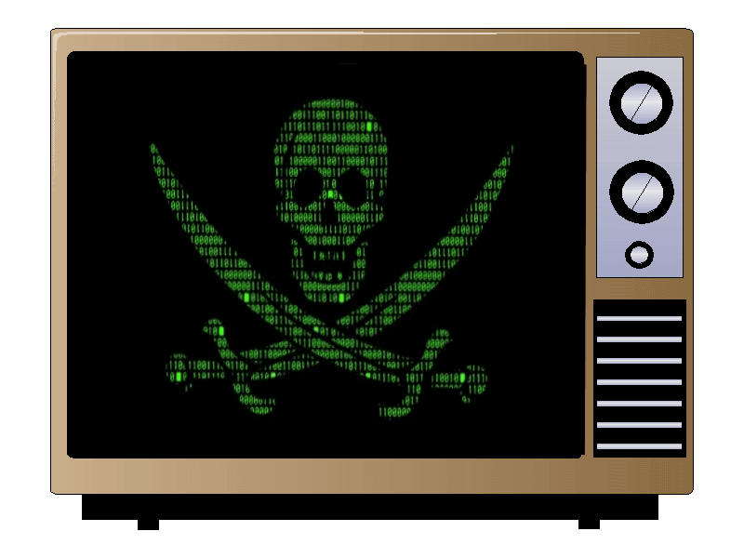
Story Time
Not even your TV is safe
Notes:
Vizio Televisions
TV’s connected to a dedicated website that contained a self signed certificate.
Certificate was not safe and researchers were able to replicate file system to find self signed certs has and salt.
Using this, it would be possible to intercept responses and show anything on the screen.
Worse yet, this might allow hackers into the local network where traffic is “generally” trusted.

Slide 38
Wiki Leaks
According to WikiLeaks, Apple's iPhone, Google's Android, Microsoft's Windows and Samsung smart TVs were among CIA targets.
The TVs can be placed in a "fake off" mode, so the owner falsely believes the TV is off when it is on, the documents say. "In 'fake off' mode the TV operates as a bug, recording conversations in the room and sending them over the Internet to a covert CIA server," WikiLeaks says.
Notes:
The CIA basically has zero day exploits on all modern phones and operating systems and at the time of the release even Apple still had 8 of 14 issues holes that needed to be filled.

Slide 39
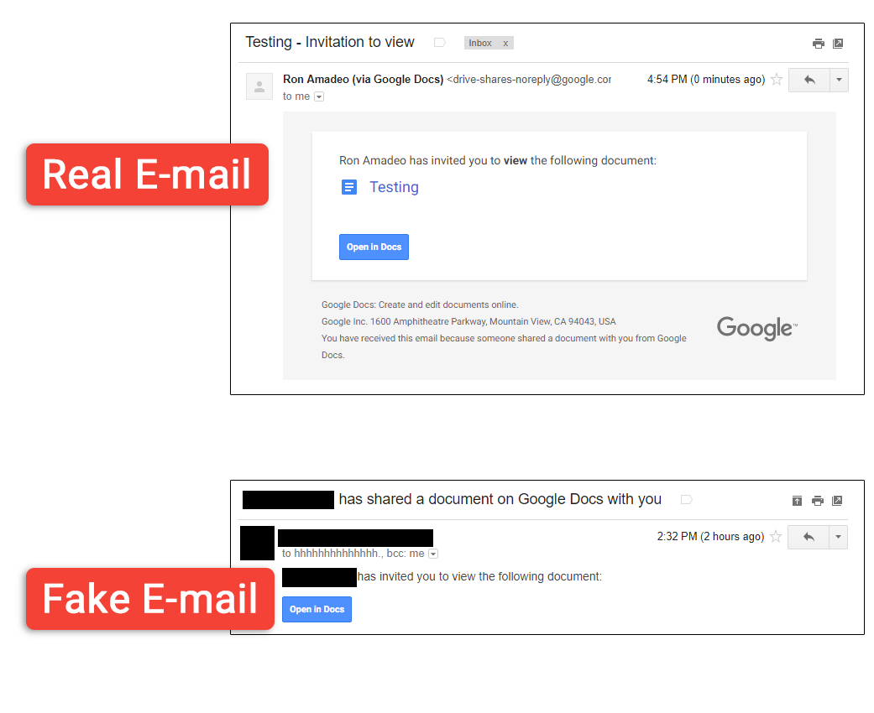
Google Doc Phish
https://arstechnica.com/security/2017/05/dont-trust-oauth-why-the-google-docs-worm-was-so-convincing/
Notes:
The interesting thing about this worm was just how convincing it was. The e-mail was great—it used the exact same language as a Google Docs sharing e-mail and the exact same "Open" button.
If you opened the document and logged in through oauth, the worm would grab all your contacts and email who knows what.
Thankfully, Google was able to shut down the service so this should not be an issues.

Slide 40
Securing Data on the Open Seas
Protect our plunder
Plunder Loot
Profit
Make it hard to read
Watch for threats
Tools of the Trade
Put deadly obstacles in the way
Scan the horizon
???
Chart Our Course
Notes:
Protect our Plunder – Talked about what our plunder is, why we should encrypt, and how to garner trust
Charting our course – Talked about the two protocols, how they work, and a quick guide on how to setup a certificate on the server

